Slide 1
Life Satisfaction 2020 Pandemic
By Ian Harr

Slide 2
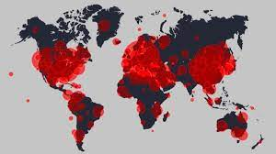
Problem
-Find life satisfaction by country for the year 2020
-Why 2020?
- 2020 was selected because that was the year Covid-19 took full swing worldwide

Slide 3

Application in real world
-The objective was to see what countries were able to maintain a high life satisfaction during a tough time such as the pandemic.
-This information could be useful for people who are looking to move internationally
-They could be worried about moving to another country and this information could help finalize a decision.

Slide 4
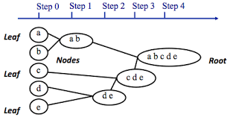
Approach
- How did we solve this problem?
-The approach used was hierarchical clustering…
-AGNES is used for Agglomerative clustering. This takes each object and considers it a single-element cluster.
-Two elements that are similar are combined into a new bigger cluster and so on.

Slide 5
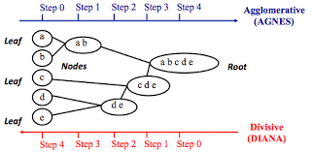
Cont.
-DIANA is used for Divisive hierarchical clustering.
-This approach is opposite of Agglomerative
-All objects start in a single cluster and at each iteration, the most heterogeneous cluster is divided into two.

Slide 6
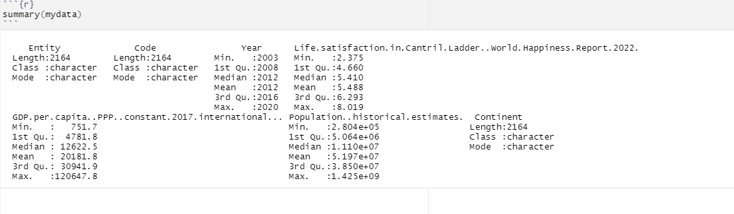
DATA

Slide 7
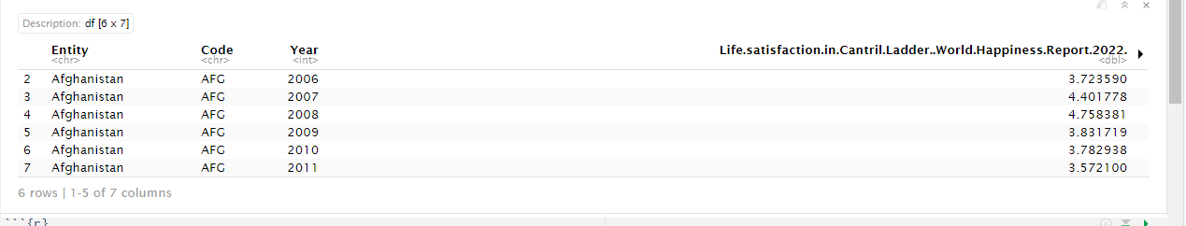
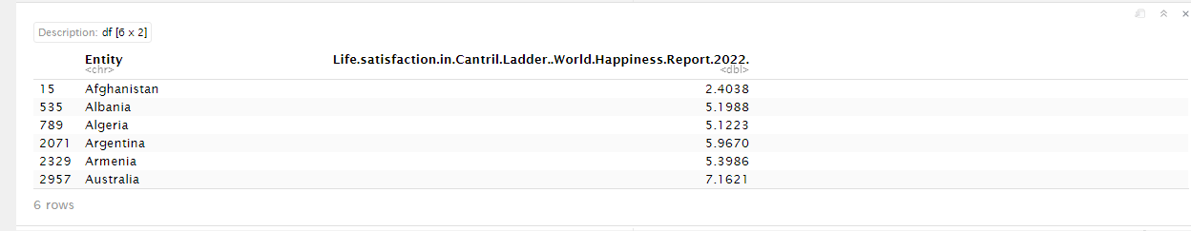
Results
-The dataset had to be reduced so that there was one entity foreach country for the year 2020
-This would allow for the focus of the pandemic year life satisfaction by country

Slide 8
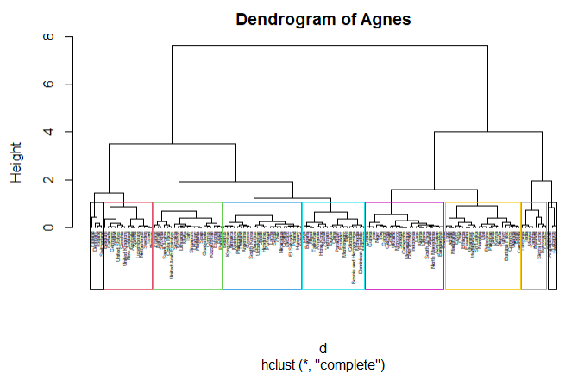
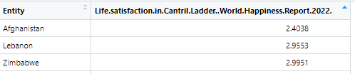
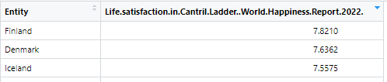
Cont.
-Agnes was used to create a Dendrogram and results were compared to the table

Slide 9
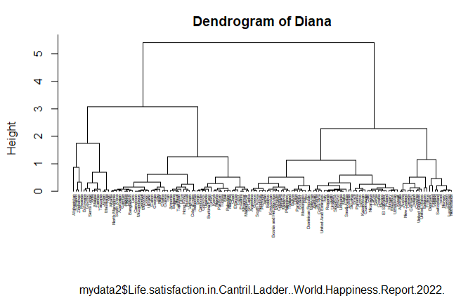
Cont.
-Diana was used to create a Dendrogram and results were compared to the table
-Results are similar but in opposite manner

Slide 10
Conclusion
-Results between Agnes and Diana were very similar with some slight differences meaning our Dendrogram results match our data respectively
-Best countries to live in base on life satisfaction are Finland, Denmark, and Iceland.
-Worst countries to live in based on life satisfaction are Afghanistan, Lebanon, and Zimbabwe
-The Dendrograms did a great job separating the countries in groups with very similar life satisfaction

